Slide 1

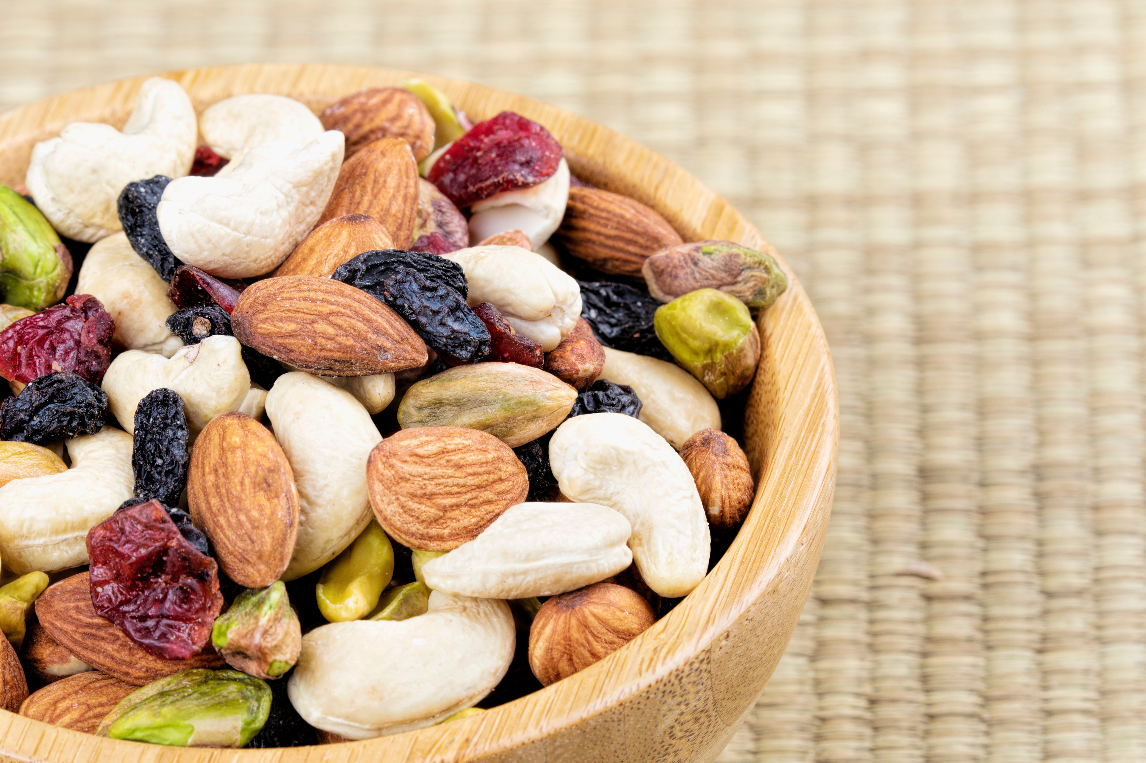



.Inspire Explore.

Slide 2

Unlock Your Entrepreneurial Potential
EIT Food
Improving food together
FREE
PRACTICAL
FOOD
SELF
& FLEXIBLE
APPROACH
INDUSTRY SETTING
PACED
Online entrepreneurship course on the Canvas platform
Learn to turn ideas into impactful food system innovations
Designed for future changemakers in agrifood and sustainability
Completing the course takes about a total of 4 hours

Slide 3


You Will Learn
Inspire Explore
Competencies and Skills to Develop
Competency Framework
ENTREPRENEURSHIP​
FOOD SYSTEMS
EXPLORE LEVEL
Module 1
Module 2
Understanding the Problem
Delivering the Solution
Identify global food system challenges
Use the problem tree technique
Define your customer and market gaps
Create a compelling value proposition
Stakeholder and sustainability focus
Understand key activities and partners

Slide 4
You Will Learn
Inspire Explore
Competencies and Skills to Develop
Module 3
Module 4
Communicating Your Idea
Managing Money
Marketing & brand positioning
The ABCDE model
Practice real-world business storytelling
Cash flow essentials
Startup funding basics
Smart budgeting

Slide 5

Go Beyond - Compete & Win!
Inspire. Explore. Compete.
Win big!
  Prepare your slide deck linked to one of the EIT Food missions:
Healthier Lives Through Food
Reducing Risk for a Fair & Resilient Food System
A Net Zero Food System
READ MORE​
READ MORE​
READ MORE​
  Pitch your idea in a real competition!
  Win cash prizes of up €2000 to and gain visibility!
  Get expert feedback on your business idea!
Terms: Open to all participants who complete the Inspire Explore course. Runs from October 1st to November 30th, 2025.

Slide 6
Why Join?
Inspire Explore
Take the course and:
SOLUTION-ORIENTED
PRACTICAL
EXPERT-LED
Tackle food system challenges with purpose
Build practical entrepreneurial skills
Learn from EIT Food - Europe’s leading food innovation initiative
CAREER BOOSTER
NETWORK
Boost your CV with an EIT Labeled Certificate of Completion
Join a community of mission-driven peers

Slide 7
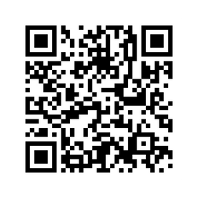
Get Started Today!
Sign up for Inspire Explore
PRICE
Free
REGISTER FOR FREE!
REGISTRATIONS
Start anytime and finish by December 31st to receive your Certificate of Completion
NEXT STEPS
Enter the Inspire. Explore. Compete. Coopetition by November 30th and take your shot at winning up to €2000!

Slide 8

Thank You!
Contact us at
core.inspire@eitfood.eu

